Slide 1

Find Job Application & Recruitment Analytics
Mini Project
By
Dhivyasree V

Slide 2
Introduction
Freshers may find it difficult to choose the right job and skill-matched opportunities.
Experience candidates may find it difficult to suitable role with the right salary.
Recruiters may find it difficult to manage many application and track candidate status.
This project provide clear insights into application , salary, skills, experience and recruitment status.
It help in making better job and hiring decisions.

Slide 3
Problem Statement
The project focuses on analyzing:
Application by Job Type – Compare applications across job types.
Expected Salary vs Offered Salary – Compare expected and offered salary.
Highest Skill Match – Identify the highest skill-match level.
Application Trends – Analyze application trends over time.
Gender Based Status – Analyze recruitment status by gender.
Experience Level Analysis – Analyze applications by experience level.
Salary Gap vs Selected – Analyze salary gap based on selection.
State Wise Application Count – Analyze applications across states.
Application Source – Identify the major application sources.
Industry Performance – Compare application performance across industries.

Slide 4
Business Problems
Core Challenges:
Large number of job applications makes it difficult to track candidates manually.
Recruiters need to identify which job roles and sources attract more applicants.
It is difficult to monitor candidate status and recruitment progress efficiently.
A single dashboard is needed to analyze application trends and recruitment outcomes.
Manual analysis makes it harder to identify hiring patterns and make data-driven decisions.

Slide 5
Tool Used
Microsoft Excel Used for data analysis, calculations and dashboard creation.
Microsoft Excel Features Used:-
Pivot Tables Pivot Charts Slicers Conditional Formatting Data Visualization
Power Query Used for cleaning, transforming and preparing the recruitment data.

Slide 6
Data Pre-Processing
General Data Cleaning
Removed empty/unnecessary values.
Handled missing values.
Corrected data types.
Cleaned and standardized the data.
Used trim Function to Text data type
Salary Data Cleaning
Cleaned Salary Offered and Salary Expected columns.
Removed the “Rs” currency text from salary values.
Converted salary values into a consistent numeric format.
Converted salary values into LPA for analysis.
Created cleaned salary fields: Salary_Offered_LPA_Clean & Salary_Expected_LPA_Clean
Used the cleaned salary fields for Expected Salary vs Offered Salary analysis.
Used if function for condition.

Slide 7
Data Pre-processing – IF Function
IF Function – Power Query
used the IF function in Power Query to apply conditions to the salary data.
The IF function checks a condition and returns one value when the condition is True and another value when the condition is False.
In my project, I used this logic to clean and prepare the salary values for analysis.
Basic syntax:
if condition then value1 else value2
For example:
if [Salary_Offered]>100 then [Salary_Offered]/100000 else [Salary_Offered]
This checks whether the offered salary is missing.
If the condition is True, the expected salary is used.
If the condition is False, the offered salary is retained.

Slide 8
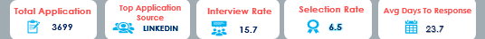
KPI( Key Performance Indicators)
Total Application- 3699
Top Application Source- LINKEDIN
Interview Rate- 15.7%
Selection rate- 6.5%
Avg Day To Response- 23.7%
“A Quick Overview of Recruitment Performance”

Slide 9
Charts
1.Application by Job Type
Used Chart: Bar Chart
Why: To compare different job types.
Explain: This chart shows which job type receives the highest number of applications.

Slide 10
2.Application Trends Chart: Line Chart Why: To show changes over time. Explain: This chart shows how the number of applications changes from month to month.

Slide 11
3.Expected Salary vs Offered Salary Chart: Column Chart Why: To compare two salary values. Explain: This chart compares the salary expected by candidates with the salary offered by companies.

Slide 12
4.Industry Performance Chart: Bar Chart Why: To compare different industries. Explain: This chart shows which industry receives more applications.

Slide 13
5.Application Source by Candidate Chart: Bar Chart Why: To compare recruitment sources. Explain: This chart shows which platform brings the most candidates.

Slide 14
9.Highest Skill Match Chart: Bar Chart Why: To compare skill-match levels. Explain: This chart shows candidates with a higher match between their skills and the job requirements.

Slide 15
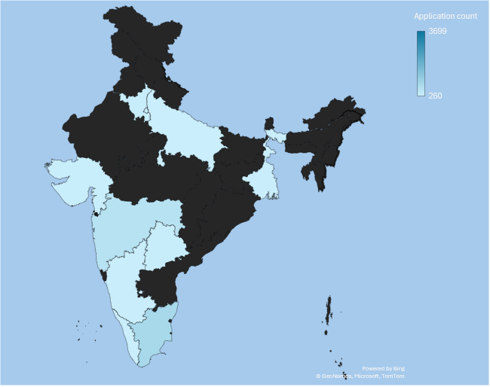
10. State-wise Application Count Chart: Map Chart Why: To show geographical distribution. Explain: This chart shows which states have more job applications.

Slide 16
Conclusion
The dashboard converts raw application data into useful business insights.
Recruitment data was cleaned and prepared using Power Query. 10 Pivot Tables were created to summarize the data.
5 KPIs provided a quick overview of recruitment performance. Pivot Charts helped to visualize recruitment patterns clearly. It supports better and data-driven recruitment decisions.

Slide 17
Future Scope
Predict Future Hiring Demand – Which roles will be needed more in future.
Reduce Hiring Cost – Identify cost-effective recruitment methods.
Improve Employee Retention – Find patterns that may help reduce early employee turnover.
Plan Workforce Better – Help companies plan future hiring based on business needs.
Improve Recruitment Strategy – Use data insights to make the overall hiring process more effective.

Slide 18
Thankyou

